Slide 1

Prenatal diagnosis and disability rights: plus ça change, plus c'est la même chose?
Prof. Aviad Raz,
Dept. of Sociology and Anthropology
Ben-Gurion University, Israel
Antony Gormley, Feeling Material

Slide 2
Making Use of The Disability Perspective
The Disability Critique has profound implications
Until now, however, its far-reaching demands have not been recognized by the public and/or implemented by the State or the medical profession
To make an impact it should become part of a dialogue with other perspectives

Slide 3
A Brief History
The “disability critique” has two major premises (Parens & Asch, 2000):
First, prenatal diagnosis is morally problematic – the “expressivist argument”
Second, prenatal genetic counseling is driven by misinformation.

Slide 4
The Expressivist Argument has not, and probably will not, impact the growing prevalence of prenatal testing
'The message at the heart of widespread selective abortion on the basis of prenatal diagnosis is the greatest insult: some of us are ‘‘too flawed’’ in our very DNA to exist; we are unworthy of being born’
(Disability critic Marsha Saxton, 1997: 331).

Slide 5

Early 1990’s CAMPAIGN FOR DOWN SYNDROME
“Statistics show that over 90% of pregnancies are terminated if the fetus has been diagnosed with Down syndrome. Many health professionals like to describe all the possible medical problems children with Down syndrome might encounter without mentioning any of the positive aspects, such as: how a child with Down syndrome might lead a healthy, rewarding and rich life, often times not that much different than a child who does not have Down syndrome.
So, why, and by whom, has it been decided that all pregnant women should be offered screening aimed to detect, and prevent Down syndrome? And why are these tests offered without appropriate counseling, and complete and balanced information?”

Slide 6
The DS Association POSITION STATEMENT ON PRENATAL TESTING and EUGENICS
1. Disability groups should prepare packets of up-to-date information to be offered to all parents who learn that their fetus has a disabling condition. These packets should contain:
a. Information that seeks to dispel common misconceptions about disability and present disability from the perspective of a person with a disability;
b. Information on community-based services for children with disabilities and their families as well as on financial assistance programs;
c. Materials on special needs adoption; and
d. A summary of major laws protecting the civil rights of persons with disabilities. People with disabilities and parents of people with disabilities should be available to talk with future parents.
2. All medical students should be required to take at least one course in political and social issues of disability and all practicing physicians should be required to take such a course as part of their continuing education requirements. All genetic counselors, as a part of their specialized training, must participate in an activity that will give them contact with persons with disabilities in non-medical settings.
3. Family strengthening initiatives such as parental leave, part-time and flextime work, expanded child care alternatives, comprehensive health care programs and programs assisting low income families must be supported. Parenting a child with a disability will become a more viable option for more people if society provides more supports for parents in general.
1994

Slide 7


The Disability Critique, 2nd Round
2016 - UK Down’s syndrome advocates launched a new campaign after the UK National Screening Council released its decision to recommend the implementation of non-invasive prenatal testing (NIPT)

Slide 8

The Return of the Expressivist Argument?

Slide 9
NIPT regulations and guidelines in Germany
Pregnant women should:
-- receive comprehensive information from a qualified physician as per the Genetic Diagnosis Act (GenDG) as well as the Genetic Diagnostics Commission guidelines, and undergo non-directive counselling
--- be in the 10th week of pregnancy (Gestational Week 9+0) or later.
--- exhibit one of the following indications for performing NIPT:
*Advanced age (35 years or older)
*Fetal ultrasound findings indicating an increased risk of trisomy 13, 18 or 21
*Suspicious serum markers for trisomy 13, 18, or 21
*Trisomy 13, 18 or 21 in family history or in a previous pregnancy
*Other medical reasons (joint decision between doctor and patient)

Slide 10
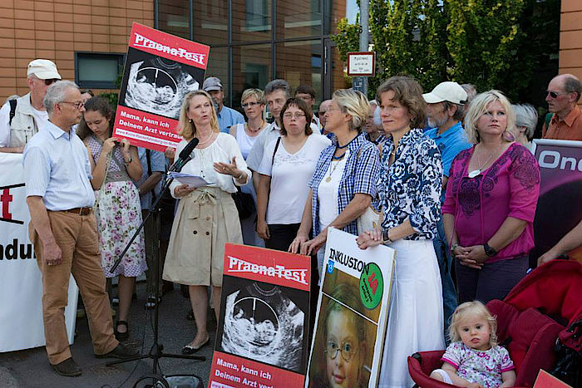
Praena-Test_Demonstration_Konstanz_2014_3

Slide 11
No public debates or campaigns against NIPT (or prenatal diagnosis generally) in other parts of the world, e.g. California or Israel
Banning NIPT is neither justified nor practical
The same pragmatic recommendations raised in the context of conventional prenatal tests are also relevant in the context of NIPT

Slide 12
So how do we make use of the disability perspective?
The Disability Critique has profound implications
Until now, however, its far-reaching demands have not been implemented
Even the more pragmataic recommendations may take time and persuasion to make an impact

Slide 13
Example 1. How to define and measure the success of Prenatal Genetic Testing?
In many countries, Down’s syndrome has been viewed for most of its history as a public health problem, with prenatal screening aimed at reducing its incidence. Only recently have there been efforts to promote reproductive choice rather than test uptake as the preferred measure of this screening program’s 'success.‘
'Informed choice' was suggested in order to expand the measure of informed consent. However, it still needs to tackle problems connected to informed consent, as well as to be aptly operationalized.

Slide 14
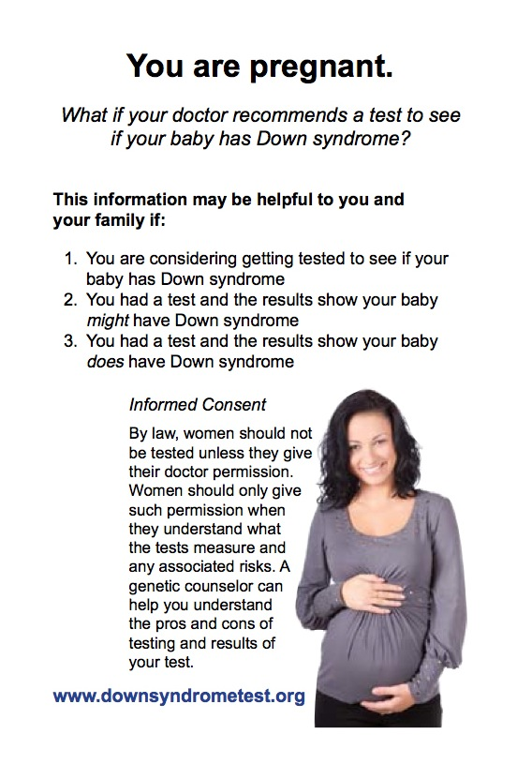
Example 2. How to provide more balanced info?
2012 - National Down Syndrome
Congress publishes a prenatal testing
pamphlet and starts a national
distribution campaign in order to
ensure that pregnant women receive
accurate information at the time of
diagnosis, as mandated by the
2008 Kennedy-Brownback legislation.

Slide 15
Did the campaigns and lobbying of the disability perspective make a difference?
It depends.

Slide 16
International differences
Terminated
Europe
Australia
North America
Live born and stillborn

Slide 17
The Israeli Case
60% termination of DS pregnancies in the secular Israeli public (between 1997-2002, data analyzed by the Dept. of Community Genetics, Israeli Ministry of Health)
Only 30% termination in the Orthodox Jewish and Muslim Arab-Israeli communities in Israel

Slide 18
DS Advocacy in Israel:
Important to Test, Important to Support
“We encourage women over 35 to do amnio. To resist prenatal genetic testing would be going against what the public wants.
I see our goal as having two aspects:
First, helping parents to prevent the birth of children with Down’s;
Second, once such children are born, promoting maximum support of them and their families.”
Chairperson, the Israeli Association for Children with Down Syndrome (2004)

Slide 19
…and following the introduction of NIPT:
“The new blood test… All the women are going to do it. They will pay as much as it costs and they will do it, because it does not carry any risk… and I think it’s their right.
Please note this is my own view. If you ask many of our members, most of them Orthodox Jews or Muslim Arab-Israelis, this is the Israeli demographics that is connected to Down, they will tell you that abortion is bad and that life with a Down child is good.
Who am I to tell women not to take the test? It is so difficult to raise such a child in a society like ours.”
Chairperson, the Israeli Association for Children with Down Syndrome (2017)

Slide 20
Major points to consider
Disability advocacy associations are important social organizations doing important work, but their voice is not (and should not be expected to be) homogenous
The Disability Critique/Perspective is not universal but culture-dependent
The Israeli DS association has taken the pragmatic interpretation of the disability perspective to its extreme

Slide 21
We need today the same things that were needed in the 90s:
Balanced information on life with disability presented before/in genetic counseling
Educating health professionals related to prenatal testing in political and social issues of disability
Parenting a child with a disability will become a more viable option for more people if society provides more support for parents in general.

Slide 22
Thank you!

